Slide 1

Computational Biology, Genetics and Epigenetics to Understand Disease Etiologies and Improve Precision Medicine
Shicheng Guo
Center for Precision Medicine Research
Marshfield Clinic Research Institute
15/05/2019

Slide 2
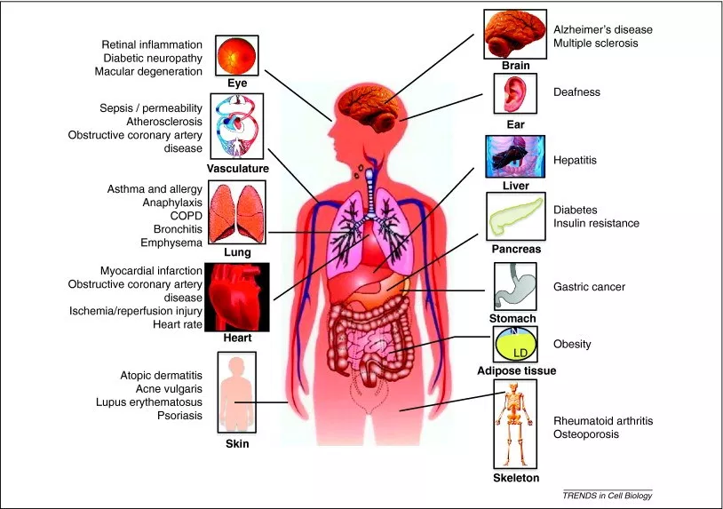
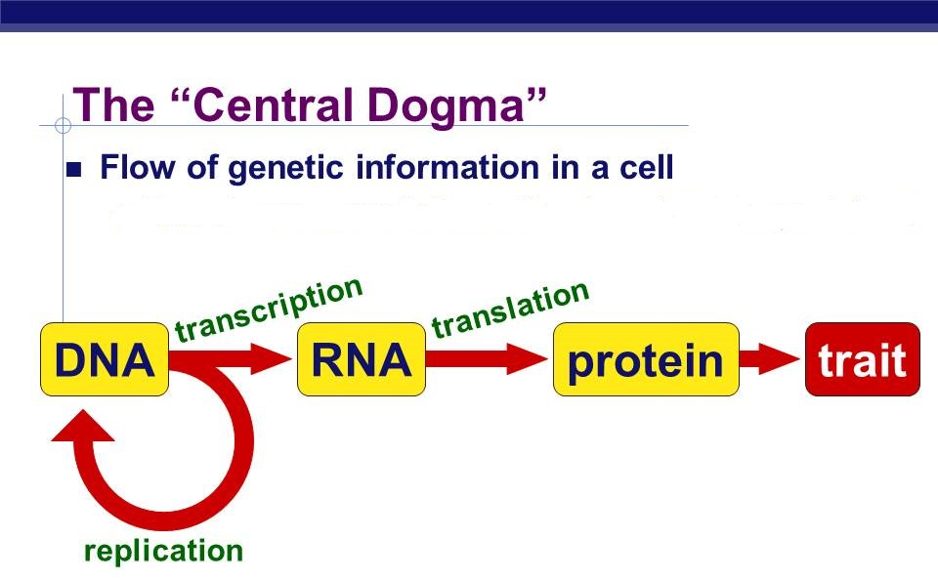
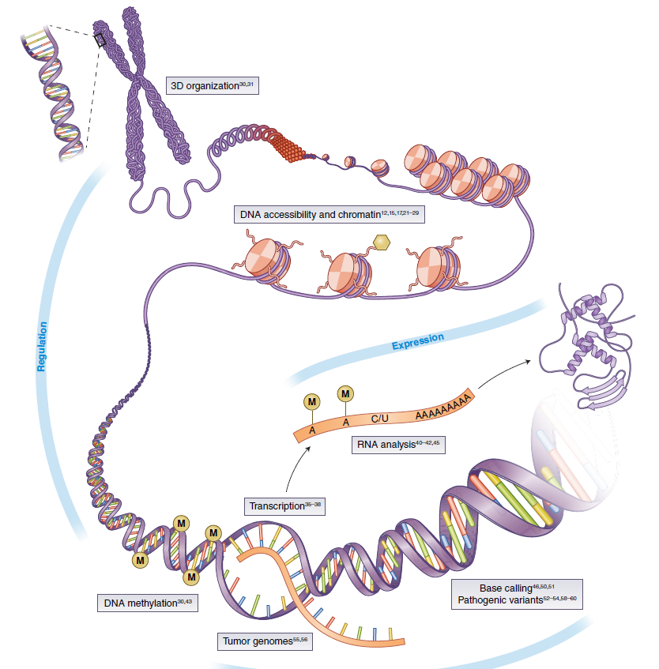
Macro and Micro View of Human Diseases in 21 Century
DNA/RNA/Protein Modification
~80 different types of autoimmune diseases
~100 different types of human cancers
~ 7,000 rare diseases
~ 12,420 total diseases (WHO, 2011)

Slide 3
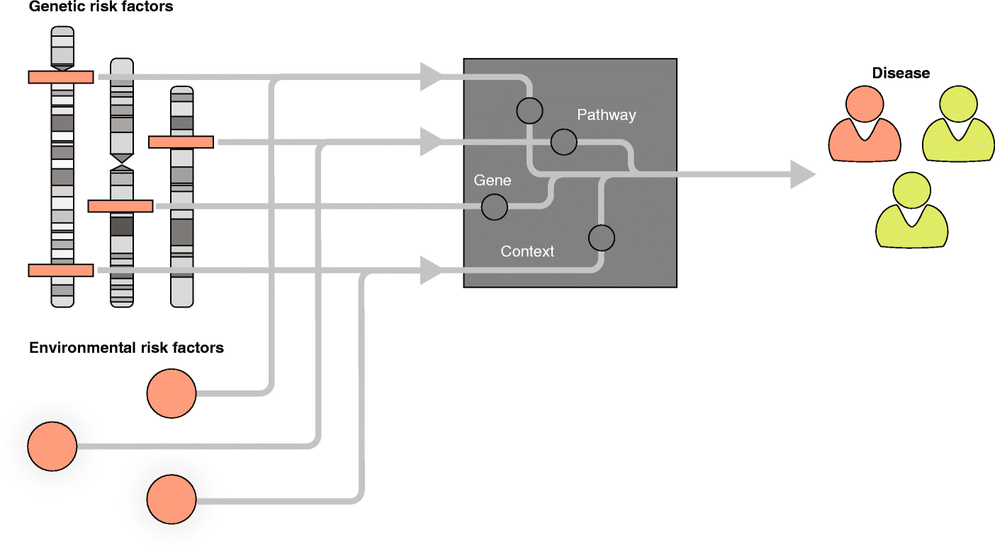
Computational Frame for Disease Etiology and Pathologies Research
Genetic risk factors
Clinical Phenotypes
Weeks
Years
Network
Pathological phenotypes
Image phenotypes
Environmental risk factors
Epigenetics risk factors
Electroencephalography (EEG)
Positron Emission Tomography (PET)
Magnetic Resonance Imaging (MRI)
Lifestyle risk factors

Slide 4
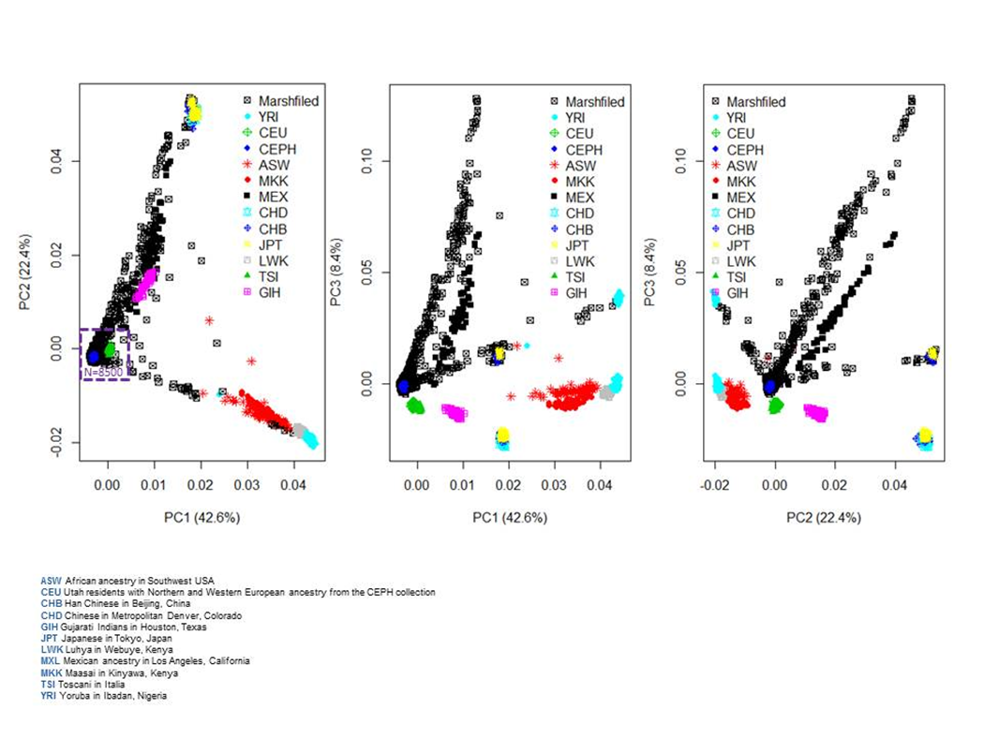

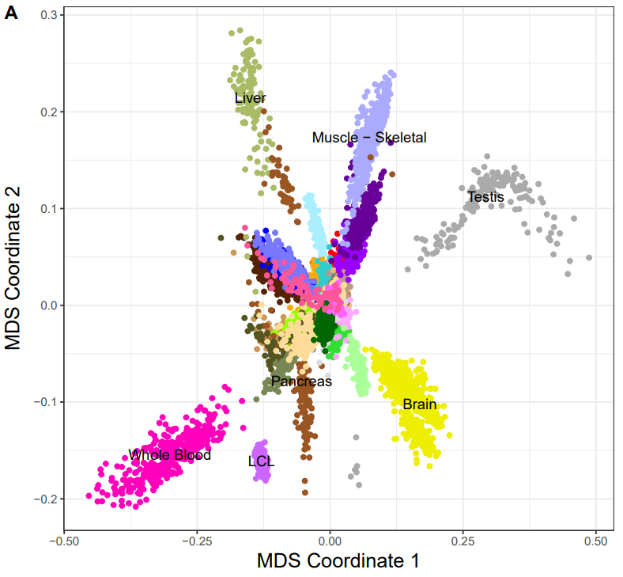
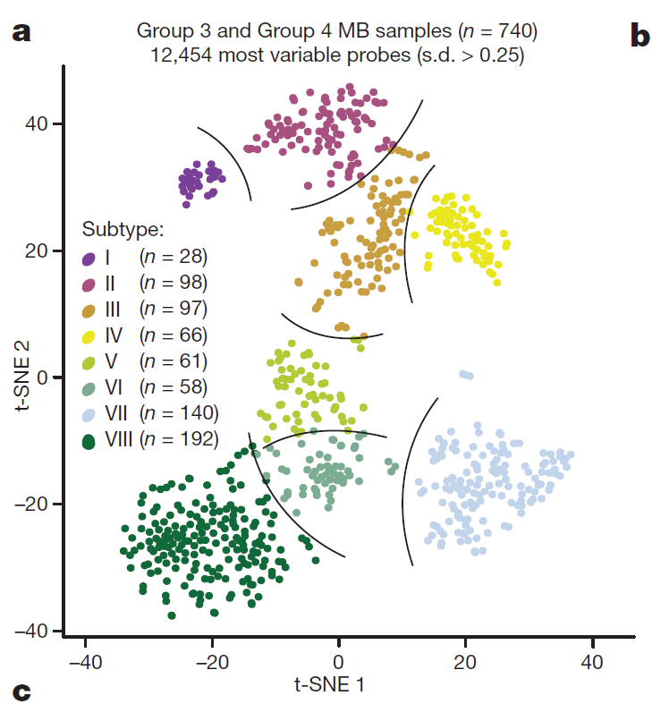
Individual, Tissue and Subtype Identification with Genomic Data
CoreExome Beadchip Genome-wide RNA-Seq data
Genome-wide DNA methylation data
Asian
Brain cancer
European
African
Brain
Unpublished data, Guo, Schrodi, 2019
Modified, Nature, 2017; 550 (7675): 204
Modified, Nature, 2017; 547 (7663): 314

Slide 5
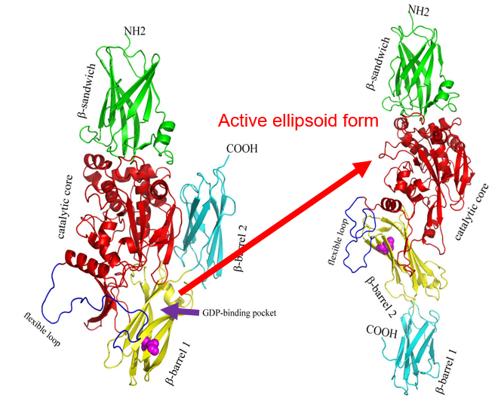
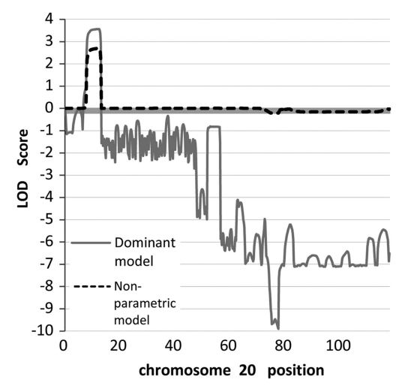
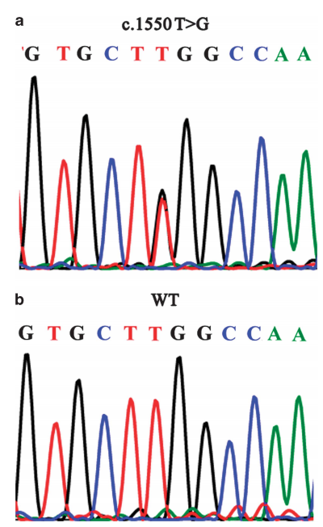
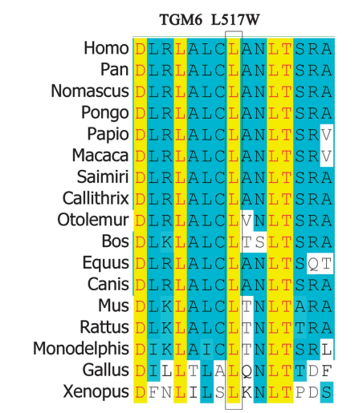
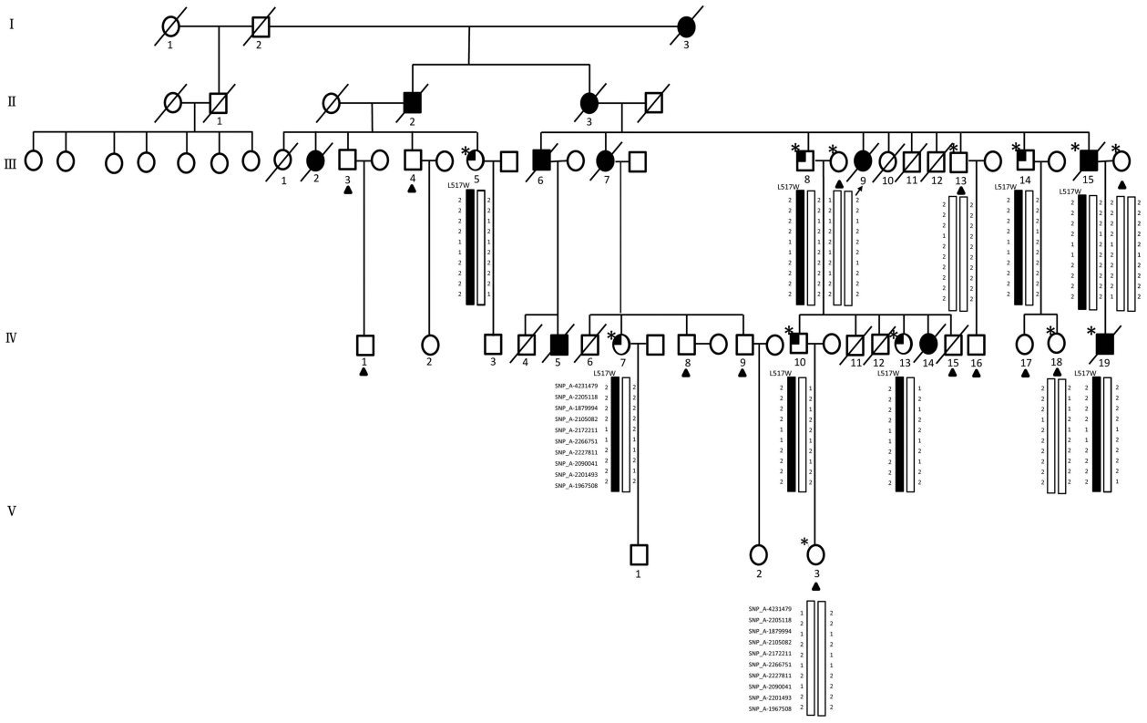
Linkage analysis to identify acute myeloid leukemia (AML) genes: TGM6
20p13
LOD: Logarithm of ODds
Autosomal-dominant AML family with 11 cases in four generations
Linkage analysis and targeted next-generation sequencing (NGS)
2 exonic variants (TGM6 and CENPB), 15 intronic, 15 intergenic and 4 UTR variant
TGM6: occurred in 2 patients and 6 members at potential preleukaemic phase, but not in 13 unaffected individuals and 530 ethnically matched healthy controls
Mutation might make TGM6 have strong GDP-binding ability and easy to transfer to active form.
Pan, Huang, Wang, Zhang, Luo, Guo, Zhang, Huang, Lin, Wang. European Journal of Human Genetics (2015) 23, 218–223

Slide 6
Informatics Strategy: Key to Precision Medicine Success
Genetic risk factors (w_{i})
Clinical Phenotypes
Weeks
Years
Image phenotypes (w_{x})
Pathological phenotypes (w_{u})
Environmental risk factors (w_{j})
Epigenetics risk factors (w_{p})
Lifestyle risk factors (w_{q})

Slide 7
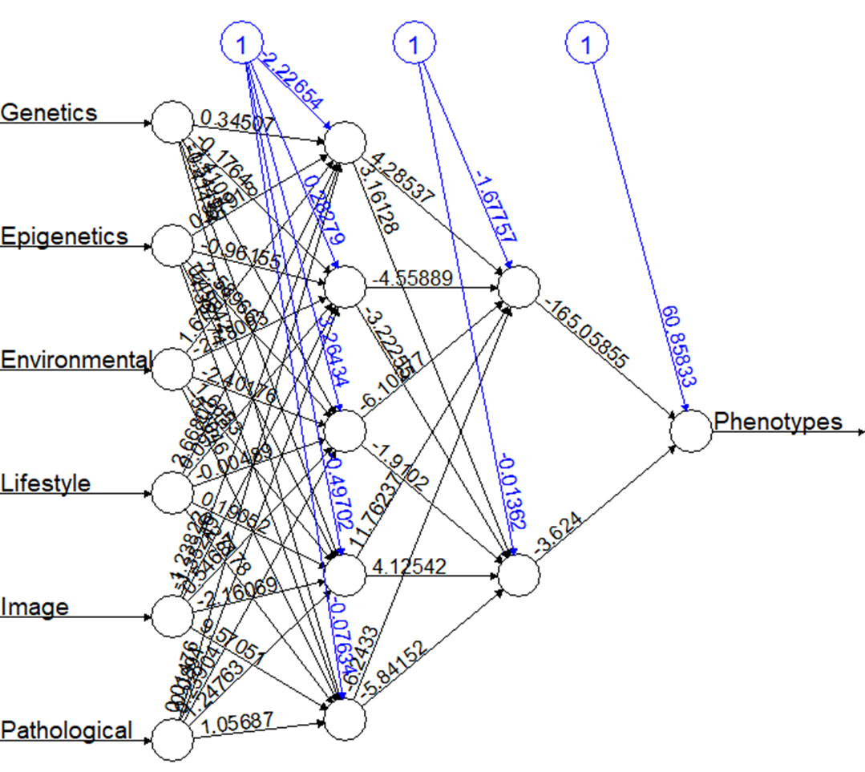
Machine Learning and Deep Learning based Prediction Models
Neural Network based Deep-Learning

Slide 8

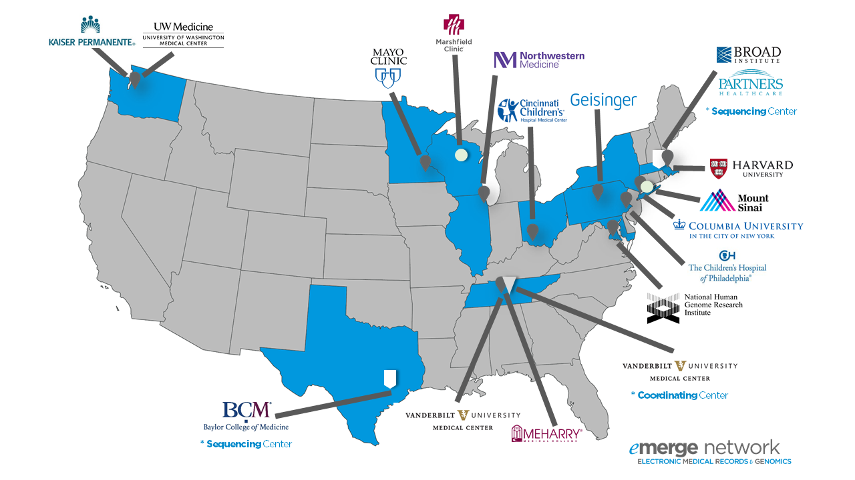
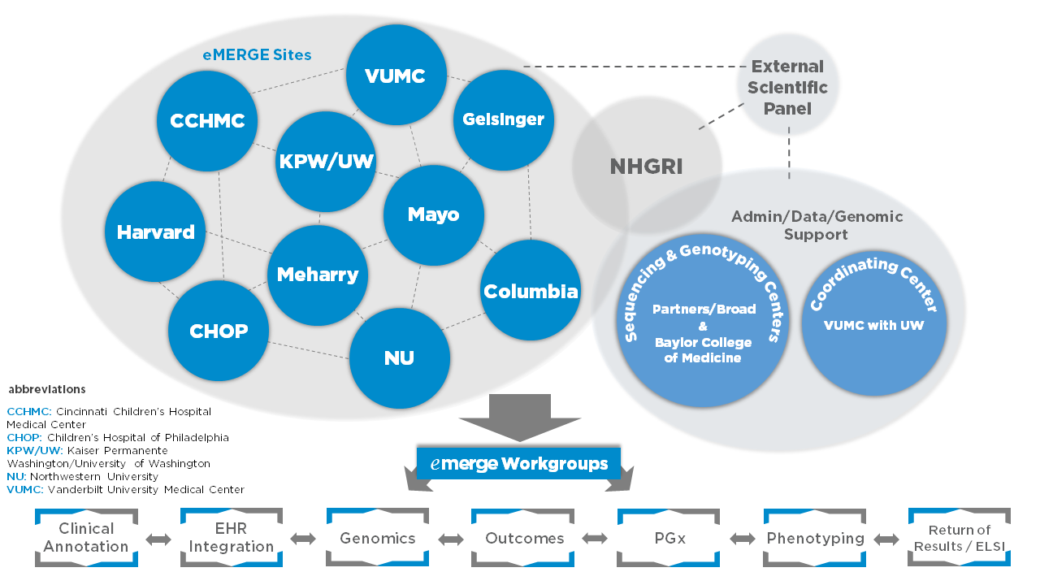
Long History of Precision Medicine of Marshfield Clinic
EHR
Precision Medicine initiative (PMI)
1960
ICD-9
2007
2019
1916
1990
2015
ICD-10
eMERGE Network
CPMR
Notes:
https://en.wikipedia.org/wiki/Marshfield_Clinic

Slide 9
Summary
Multi-Omics data Multi-Omics data
Multi-Omics data
Multi-Omics data
Multi-Omics data
Multi-Omics data
Multi-Omics data
Multi-Omics data
Multi-Omics data
Multi-Omics data

Slide 10
Dr. Shicheng Guo
Guo.Shicheng@marshfieldresearch.org

Slide 11
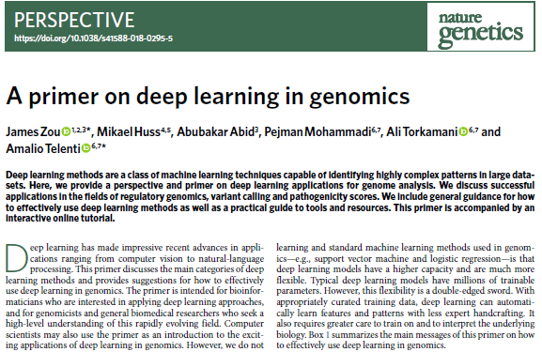
Neural Network based Deep Learning in Human Genetic Data
SRY and ATL1

Slide 12
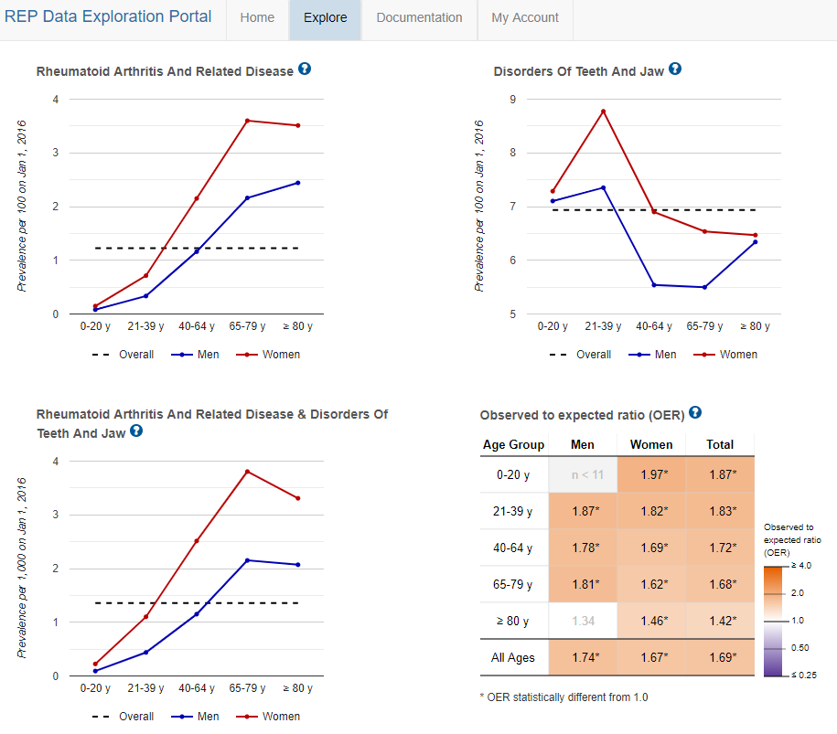
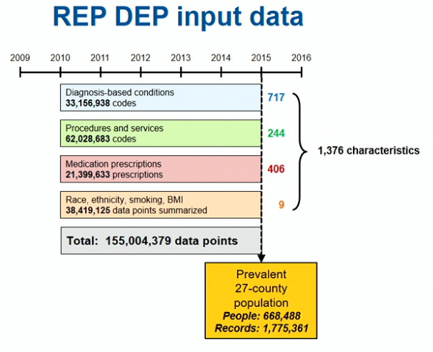
Rochester Epidemiology Project (REP)
MCRI Scientific Seminar: 02/08/2019
REP DEP from Mayo Clinic

Slide 13
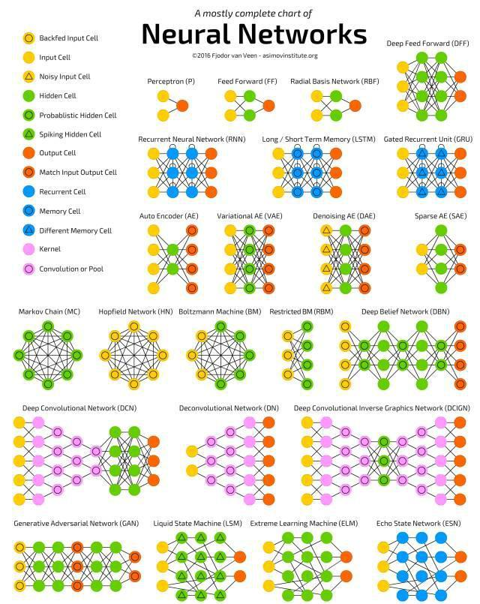

Slide 14
• 98% of patients have genetic variants that affect how well they do (or don’t) metabolize specific medications – or if the drug might have toxic effects¹ • 34% of all adverse drug reactions are caused by genetics, not drug-drug interactions²

Slide 15
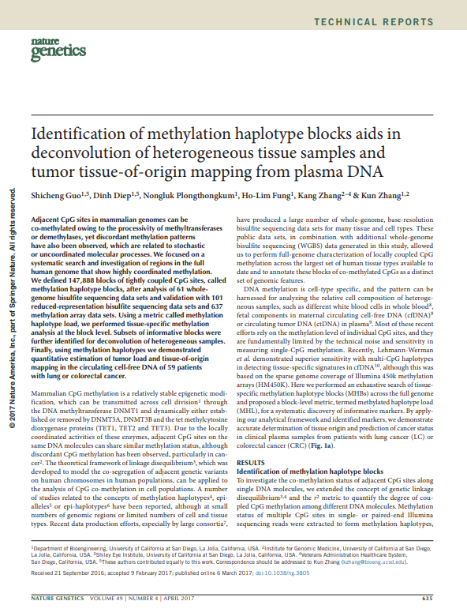

Slide 16
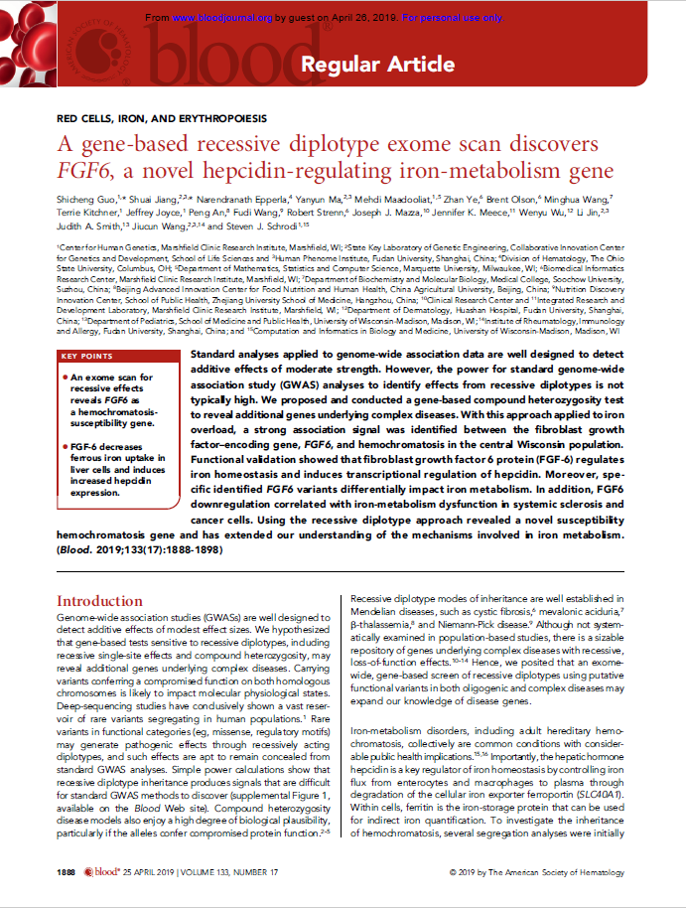

Slide 17
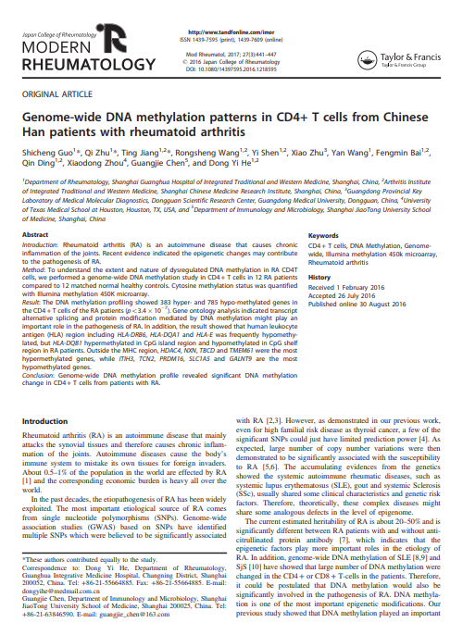

Slide 19
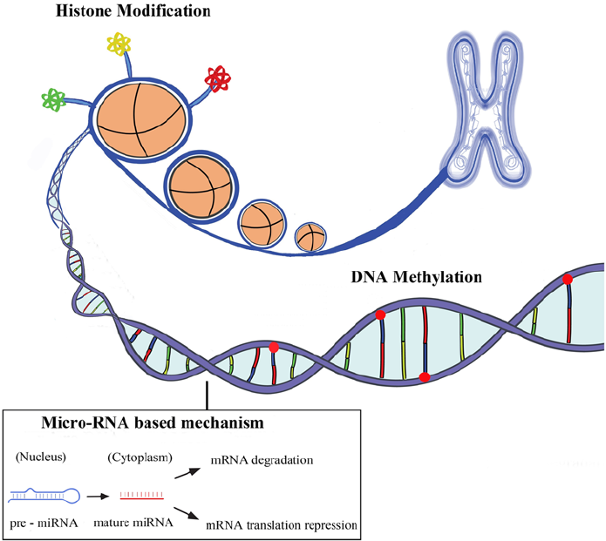
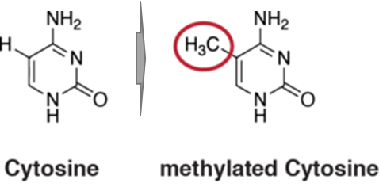
Human Genome and modification systems (Epigenetics)
DNA modification
DNA methylation
DNA hydroxymethylation
Histone modification
H3K4me1, H3K4me3
H3K27ac, H3K9ac
ncRNA system
miRNA
lncRNA
circRNA
piRNA
methyl group
Allis, Nature Review Genetics, 2016
Notes:
Our human genome is composed of A,T,C,G 4 different bases. However, human genome is not linear,

Slide 20
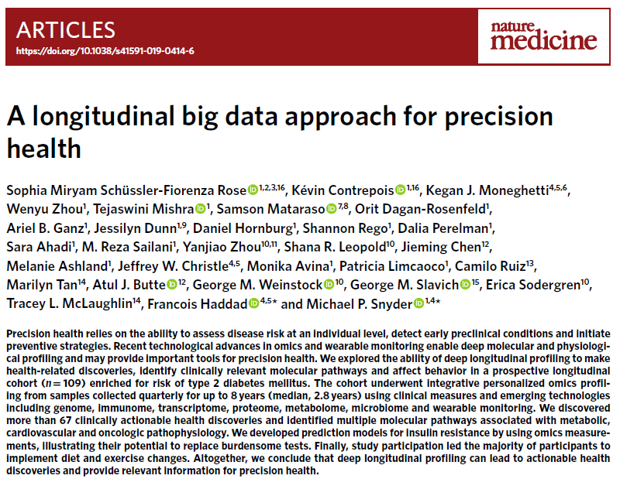
Precision medicine to common disease and rare disease
Published: 08 May 2019

Slide 21
How to Dismantle Obstacle on the Way to Precision Medicine
SNPs
CNV
Mutation
DNA methylation
RNA-seq
miRNA-seq
Bioinformatics
Clinical informatics
Image informatics
Pathology Informatics
Public health informatics
X-ray radiography
Magnetic resonance image
Notes:
Doing research is good, however, nobody want to take the risk to be the jail or life to do such research.

Slide 22
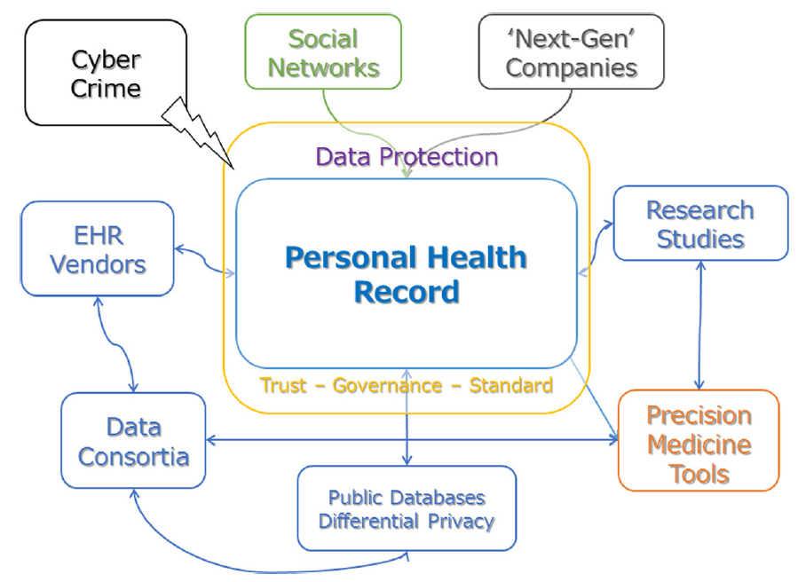

Slide 23
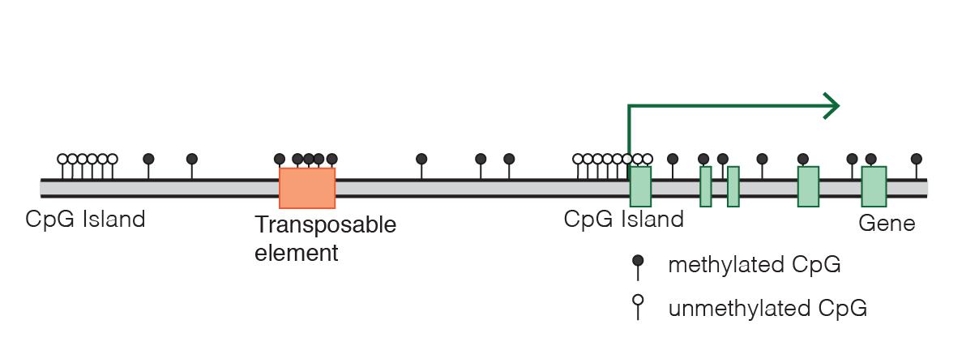
DNA methylation, gene expression and human development
DNA methylation, Wikipedia, 2019

Slide 24
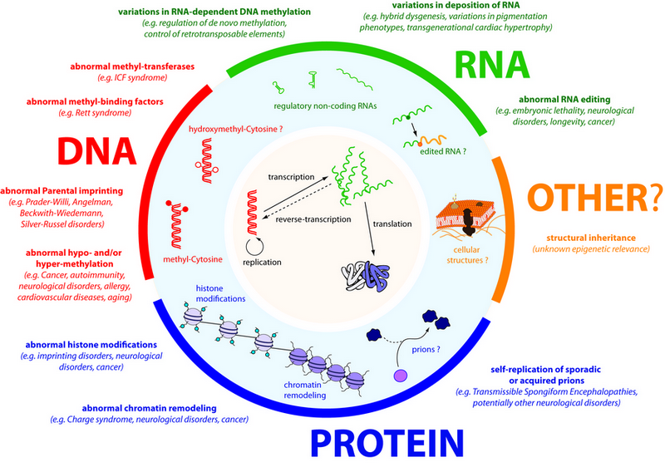
DNA methylation: powerful biomarkers for complex diseases
Almost all diseases showed abnormal methylation change
Aging can be highly predicted by methylation clock
High sensitivity: single molecular with PCR
Stable in vitro without degradation
High tissue and status specificity
Change earlier than mRNA and protein
Easy to be assembled to a multi-disease panel
Molecular biomarker, Wikipedia, 2019

Slide 25

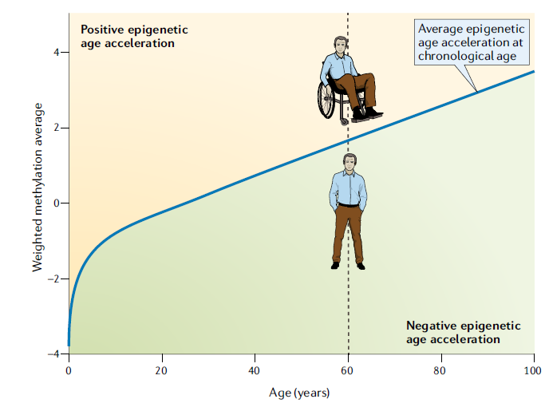
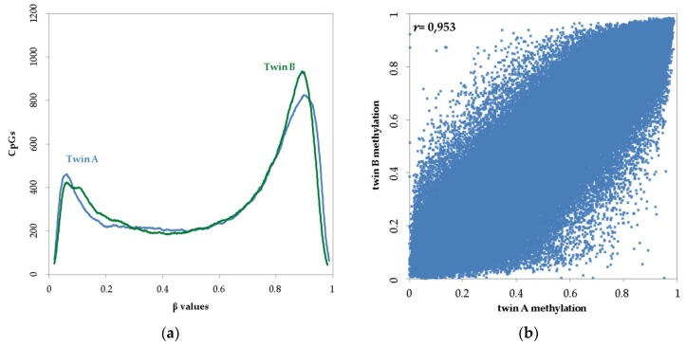
The Power of DNA methylation a biomarker
DNA ~100%
R²=0.91
DNA methylation-based age and age acceleration
Horvath, Nature Review Genetics, 2018
Guo, unpublished data
Kaminsky, Nature Genetics, 2009

Slide 26
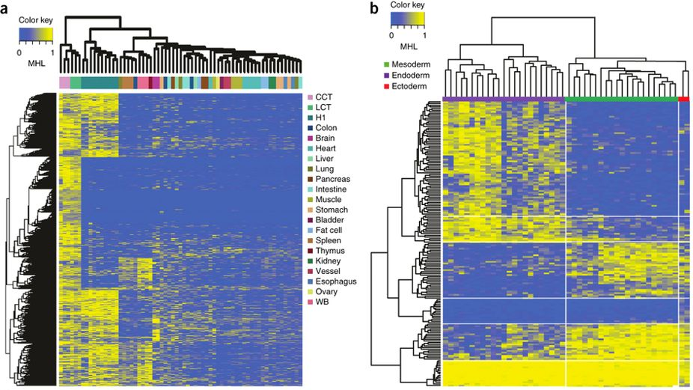
Tissue clustering based on cell-free circulating DNA methylation
Endoderm Mesoderm Ectoderm
Unsupervised clustering of human tissues using the top 15% most-variable regions from WGBS
We identified numerous germ-layer-specific methylation markers
Guo, Nature Genetics, 2017

Slide 27
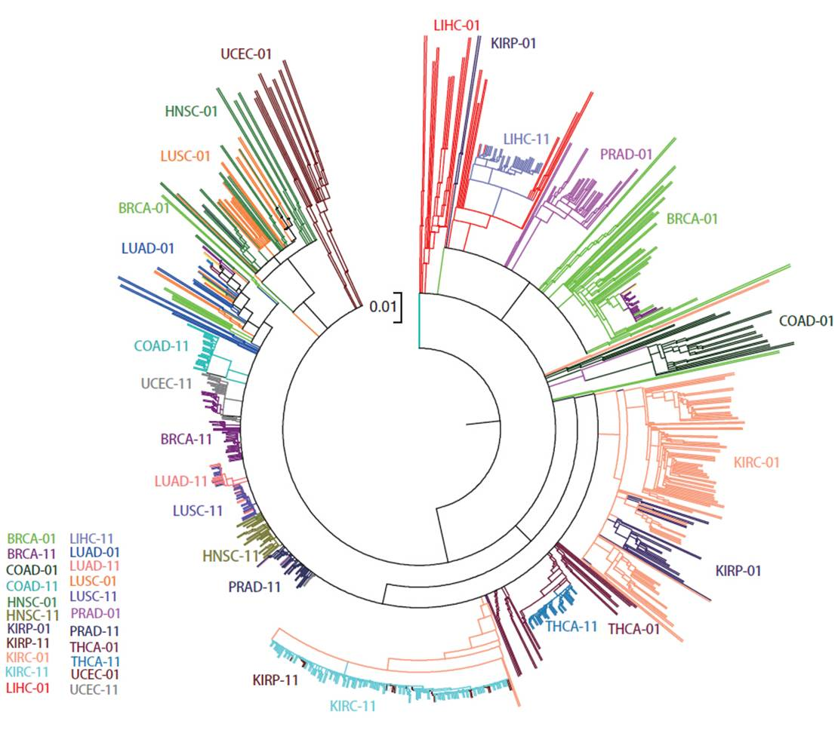
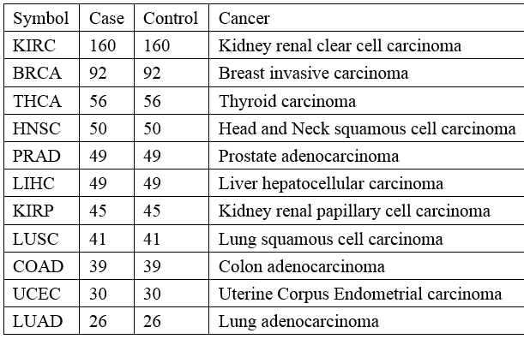

Unsupervised cluster analysis reveals cancer and normal similarity
Distance= 1-correlation
Cluster= mcquity
Pan-cancer methylation microarray dataset
11 cancer types
349,049（CpGs）$×$1278（Samples）
Guo, unpublished data

Slide 28
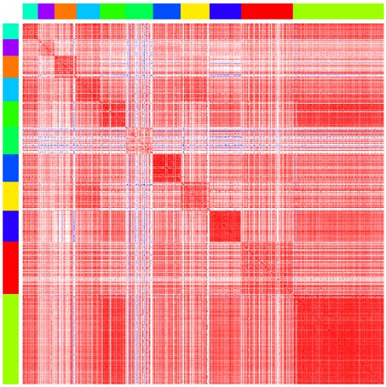
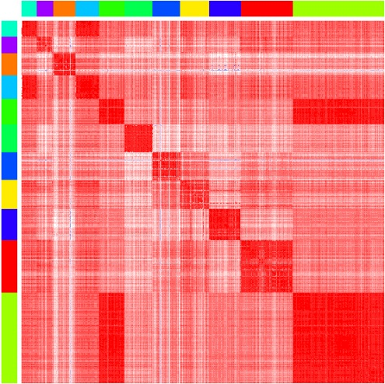
Tumor heterogeneity revealed by genome-wide DNA methylation
Lung Cancer R=0.90
KIRC and KIRP
Kidney Clear Cell Carcinoma
Kidney Papillary Cell Carcinoma
Liver Cancer R=0.84
Kidney
R=0.97
KIRC/KIRP R=0.92
LUAD UCEC COAD LUSC KIRP LIHC PRAD HNSC THCA BRCA KIRC
Cancer samples
Normal samples
Guo, unpublished data

Slide 29
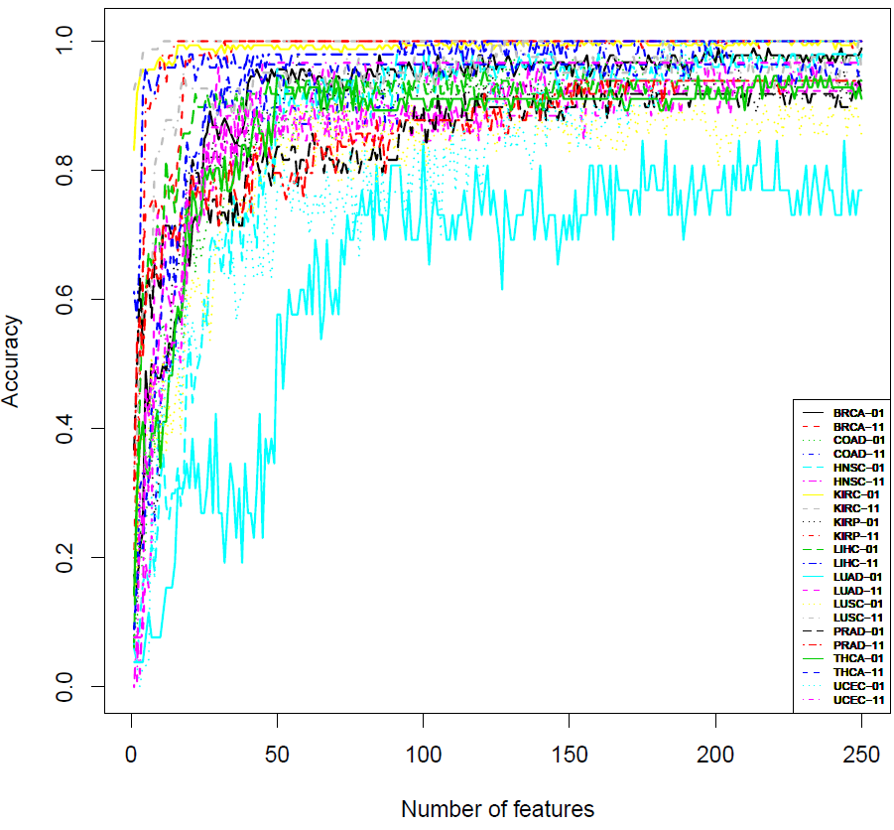
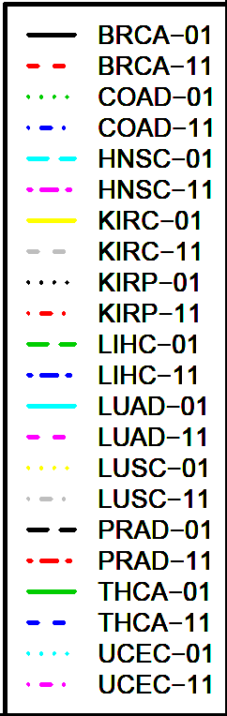
Multi-label Classification to Pan-cancer with Random Forest Method
 | Variable=25 |  |  | Variable=75
 | Sen | Spe | Acc | Sen | Spe | Acc
BRCA | 0.85 | 0.97 | 0.91 | 0.94 | 1.00 | 0.97
COAD | 0.72 | 0.85 | 0.78 | 0.92 | 0.89 | 0.91
HNSC | 0.58 | 0.72 | 0.65 | 0.94 | 0.90 | 0.92
KIRC | 0.99 | 1.00 | 0.99 | 0.99 | 1.00 | 0.99
KIRP | 0.84 | 1.00 | 0.92 | 0.91 | 1.00 | 0.96
LIHC | 0.87 | 0.96 | 0.92 | 0.92 | 0.98 | 0.95
LUAD | 0.27 | 0.73 | 0.50 | 0.58 | 0.85 | 0.71
LUSC | 0.63 | 0.93 | 0.78 | 0.78 | 0.93 | 0.85
PRAD | 0.78 | 0.82 | 0.80 | 0.86 | 0.84 | 0.85
THCA | 0.79 | 0.88 | 0.83 | 0.88 | 0.96 | 0.92
UCEC | 0.57 | 0.77 | 0.67 | 0.77 | 0.97 | 0.87
25-75 CpGs provide ~80% accuracy to 22 sample types
Guo, unpublished data

Slide 30
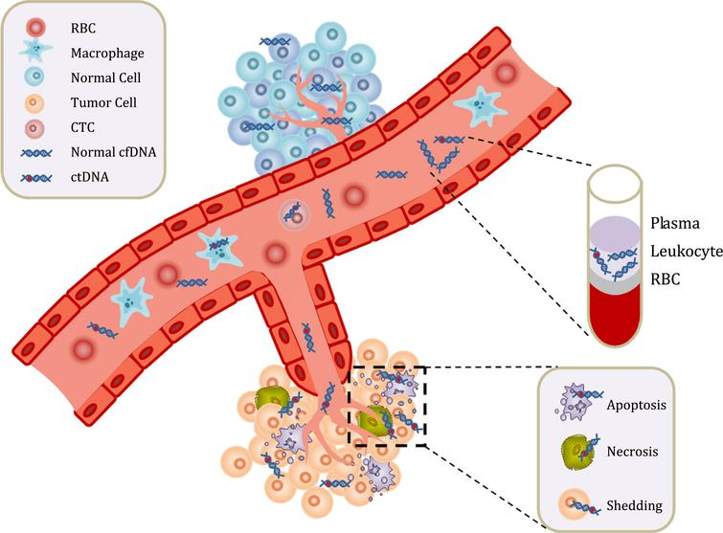
Cell-free Circulating Tumor DNA (ctDNA) in human Carcinoma
ctDNA 10-200ng/ul Plasma
Non-random distributed, repeat regions
Non-invasive diagnosis and real-time surveillance
Circulating tumor DNA, Wikipedia, 2019
Guo, unpublished data

Slide 31
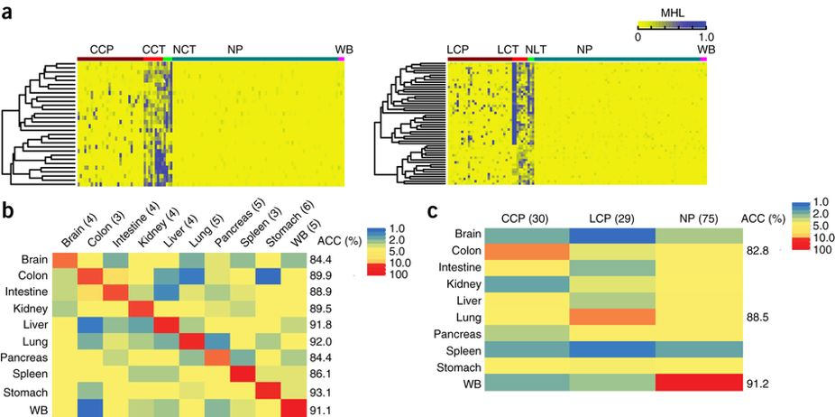
Prediction of cancer tissue of origin from plasma DNA using cell-free DNA methylation
Application of the prediction model to plasma samples from patients with CRC (n = 30) or LC (n= 29) and from healthy individuals (n = 75)
Guo, Nature Genetics, 2017

Slide 32
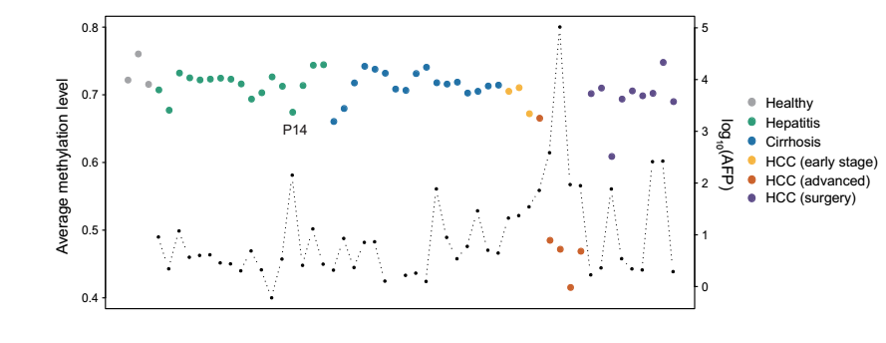
Cell-free DNA Methylation reveals Liver Disease Status
Long-region average methylation level from low-pass genome-wide DNA methylation sequencing data
2 Mbp Genome-window
Guo, unpublished data

Slide 33
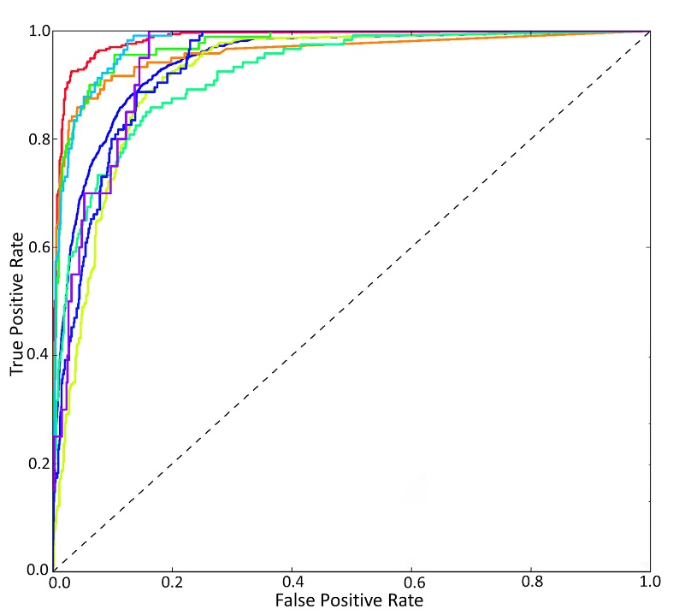
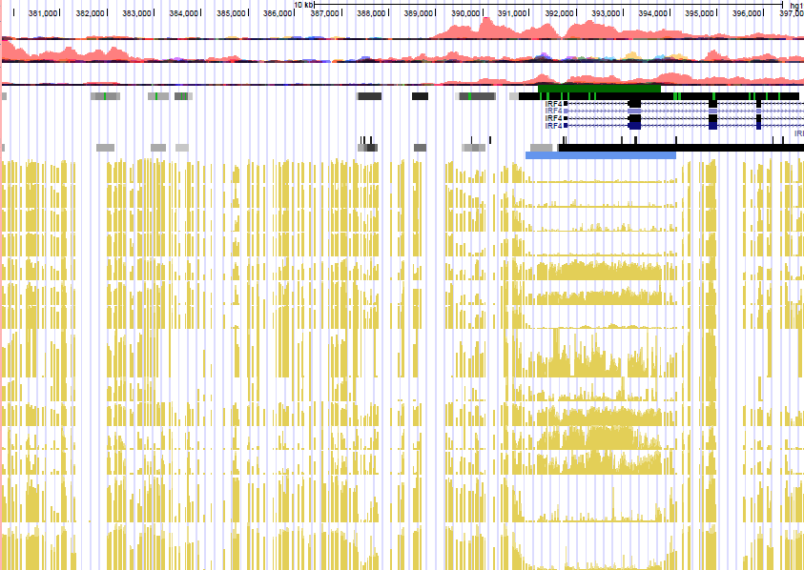
Cancer diagnosis panels to be validated in the plasma using cell-free DNA methylation
GBM: IRF4, MGMT, CD133, ARF1,C2orf40,
NULL
BRCA
COAD
GBM
HCC
KIRC
LUAD
LUSC
PRAD
UCEC
PBMC
B-cells
Neutrophil
CD4+
CRC
AML
BML
GBM
BCRA
HepG2
NSLCL
RA
OA
Brain
TCGA+GEO: 11846 cancer samples
Support vector machine (five-fold cross-validation)
Guo, unpublished data

Slide 34

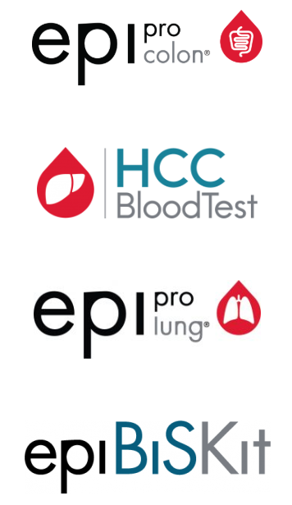

Future work
US, FDA
US20070048738A1
Prostate cancer
Glioblastoma cancer
Pancreatic cancer
Chronic lymphocytic leukemia

Slide 35
Thanks

Slide 37
GSE103659: 181 GBM with 450K
GSE114534: 44 GBM with 450K
GSE66351: 190 normal brain with 450K
GSE41826: 58 normal brain with 450K
GSE89707: 142 normal brain with 450K
GSE74486: 131 brain from Trisomy 21 causes Down syndrome with 450K
GSE36194: 724 Normal brain with 27K
GSE53229 : 145 GBM with 27K
GSE50923: 54 GBM+23 control brain with 27K
GSE46015: 3 GBM, each sample have two replicates with 27K
GSE22867: 55 GBM + 3 normal with 27K
GSE119774: 39 GBM, 41 GSC, 9 NSC with 850K
GSE116298: 12 GBM, each sample have 3 replicates with 850K

Slide 38
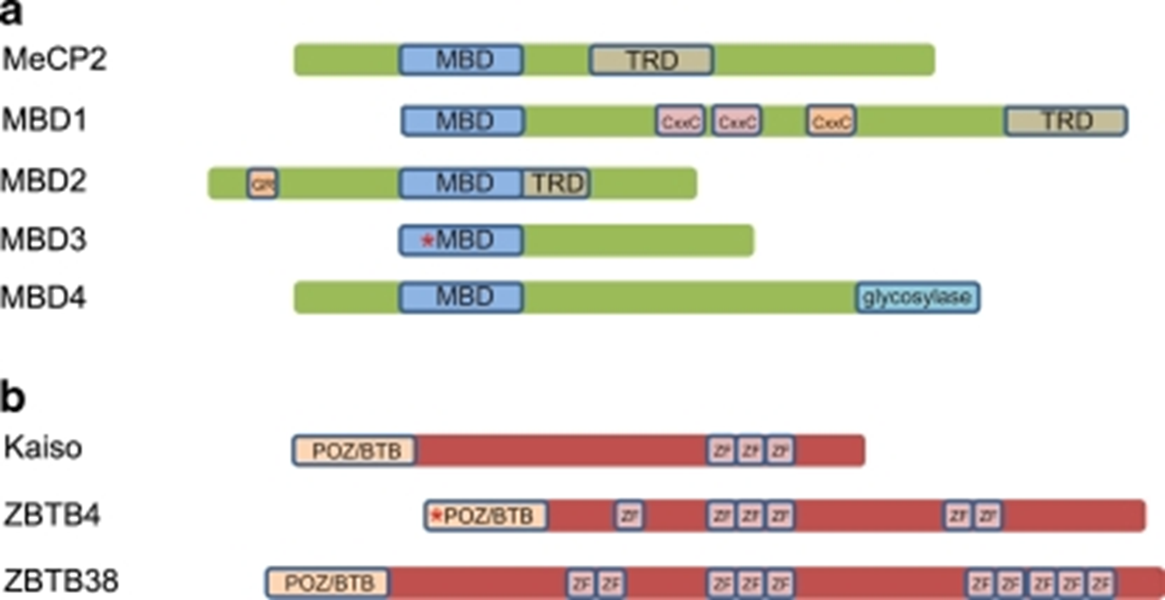
Two families of proteins that bind methylated DNA
Chromosoma. 2009 Oct; 118(5): 549–565
Notes:
Two families of proteins that bind methylated DNA. a Methyl-CpG binding proteins (MBDs): MBD proteins display homology within their MBD domains, while the transcription repression domains (TRD) described for MeCP2, MBD1, and MBD2 are non-homologous. In addition to its MBD domain, MBD1 is able to bind unmethylated DNA via its third CxxC zinc-finger motif. MBD2 features a characteristic stretch of glycine and arginine residues (GR) and has juxtaposed MBD and TRD domains. MBD3 is, due to a mutation in the MBD domain, not able to bind methylated CpGs in mammals. MBD4, a thymine glycosylase, contains a C-terminal glycosylase domain used for excision-based DNA repair. b Kaiso protein family: three members of the Kaiso protein family have been described so far. Kaiso, ZBTB4, and ZBTB38 share a triple zinc-finger domain and a BTB/POZ domain which in case of ZBTB4 contains a 60 amino acid insertion. Furthermore, ZBTB4 and ZBTB38 contain respectively three and seven additional zinc-fingers

Slide 39
Biochemical interactions of methyl CpG binding proteins
Protein | Interacting partner | Effects of the interaction | Reference
MeCP2 | Sin3A, HDACs | Transcriptional repression | Jones et al. (1998), Nan et al. (1998)
 | c-ski, N-CoR | Transcriptional repression | Kokura et al. (2001)
 | HMGB1 | Unknown | Dintilhac and Bernues (2002)
 | Sin3B, HDAC2 | Transcriptional repression | Rietveld et al. (2002)
 | Dnmt1 | Targeting of maintenance DNA methylation? | Kimura and Shiota (2003)
 | H3K9 methyltransferase | Transcriptional repression | Fuks et al. (2003b)
 | CoREST complex | Repression of neural genes | Ballas et al. (2005), Lunyak et al. (2002)
 | Brm (SWI/SNF complex) | Transcriptional repression | Harikrishnan et al. (2005), Hu et al. (2006)
 | YB-1 | Alternative splicing | Young et al. (2005)
 | ATRX | Epigenetic regulation required for neural development | Nan et al. (2007)
 | HP1 | Transcriptional repression during myogenic differentiation | Agarwal et al. (2007)
 | CREB1 | Transcriptional activation | Chahrour et al. (2008)
MBD1 | MPG | DNA repair | Watanabe et al. (2003)
 | Suv39h1-HP1 | Transcriptional repression | Fujita et al. (2003)
 | MCAF1, MCAF2, SETDB1, CAF-1 p150 | Transcriptional repressioinheritance of epigenetic states | Ichimura et al. (2005), Reese et al. (2003), Sarraf and Stancheva (2004)
 | PML-RARα, HDAC3 | PML-RARα-mediated silencing | Villa et al. (2006)
MBD2 | Mi-2, MTA1-3, P66α/β, HDAC1/2, RbAp46/48, DOC-1, PRMT5, MEP50 (NuRD complex) | Transcriptional repression | Brackertz et al. (2002), Le Guezennec et al. (2006), Zhang et al. (1999)
 | Sin3A | Transcriptional repression | Boeke et al. (2000)
 | Tax | Transcriptional activation | Ego et al. (2005)
 | TACC3, HATs, pCAF | Transcriptional activation | Angrisano et al. (2006)
 | GCNF | Oct-4 silencing | Gu et al. (2006)
 | Dnmt1 | Targeting of maintenance DNA methylation? | Tatematsu et al. (2000)
 | RFP | Enhancement of transcriptional repression | Fukushige et al. (2006)
MBD3 | Mi-2, MTA1-3, P66α/β, HDAC1/2, RbAp46/48, DOC-1 (NuRD complex) | Transcriptional repression | Le Guezennec et al. (2006), Wade et al. (1999), Zhang et al. (1999)
 | Dnmt1 | Targeting of maintenance DNA methylation? | Tatematsu et al. (2000)
 | CDK2AP1, GCNF | Oct-4 silencing | Deshpande et al. (2009), Gu et al. (2006)
MBD4 | Sin3A, HDAC1 | Transcriptional repression | Kondo et al. (2005)
 | FADD | Genome surveillance/apoptosis? | Screaton et al. (2003)
 | MLH1 | DNA repair | Bellacosa et al. (1999)
 | RFP | Enhancement of transcriptional repression | Fukushige et al. (2006)
Kaiso | Tcf3 | Suppression of Wnt signaling | Ruzov et al. (2009)
 | p120 | Wnt signaling? | Daniel and Reynolds (1999), Prokhortchouk et al. (2001)
 | N-CoR | Transcriptional repression | Yoon et al. (2003)
Chromosoma. 2009 Oct; 118(5): 549–565
Notes:
Chromosoma. 2009 Oct; 118(5): 549–565.

